Slide 1
CS 310 Operating Systems Lecture 3: Operating System Concepts – Part 2
Ravi Mittal
IIT Goa

Slide 2
Acknowledgements !
Contents of this class presentation has been taken from various sources. Thanks are due to the original content creators:
Class presentation: University of California, Berkeley: David Culler, Anthony D. Joseph, John Kubiatowicz, AJ Shankar, George Necula, Alex Aiken, Eric Brewer, Ras Bodik, Ion Stoica, Doug Tygar, and David Wagner.

Slide 3
Read the following:
Operating Systems: Principles and Practice (2nd Edition) Anderson and Dahlin
Volume 1, Kernel and Processes
Chapter 2
Chapter 26, Three Easy Pieces book

Slide 4
We will study..
Revision of concepts learnt so far in the course
The third OS Concept: Thread
The Fourth OS Concept: Dual Mode of Operation
Multiprogramming, Multiprocessing, and Context Switching - Definitions

Slide 5
Concepts we have learnt so far

Slide 6
Four Fundamental OS Concepts
Process: an instance of a running program
Protected Address Space + One or more Threads
Address space
Set of memory addresses accessible to program (for read or write)
Thread: Execution Context
Fully describes program state
Dual mode operation / Protection
User / Kernel mode

Slide 7

OS Bottom Line: Run Programs
0xFFF…
Executable
Program Source
OS
int main()
{ … ;
}
compiler
data
Load & Execute
stack
editor
Memory
instructions
heap
a.out
ELF
data
foo.c
Load instruction and data segments of executable file into memory
OS creates the process
Create stack and heap
“Transfer control to program”
Provide services to program
While protecting OS and program
instructions
0x000…
PC:
registers
Processor
ELF: Executable and Linking Format

Slide 8
What is a process ?
A process is a program in execution
The process is the OS’s abstraction for execution
Execution environment with restricted rights
(Protected) Address Space with One or More Threads
Owns memory (address space), file descriptors, sockets
Encapsulate one or more threads sharing process resources
Simplest (classic) case: a sequential process
A single thread of execution (an abstraction of the CPU)
A sequential process is
The unit of execution
The unit of scheduling
The dynamic (active) execution context
vs. the program – static, just a bunch of bytes

Slide 9
Process – Two key abstractions
Process is not the binary source code
It is an instance of running program
Process provides two key abstractions
Memory
Each process assumes entire system memory to itself
Execution
Provides abstraction of continued operation
There may be hundreds of processes in a system
Each process gets impression of continuous operation

Slide 10
Second OS Concept: Address Space
Address space ⇒ the set of accessible addresses + state associated with them:
For 32-bit processor: 2³² = 4 billion (10⁹) addresses
For 64-bit processor: 2⁶⁴ = 18 quintillion (10¹⁸) addresses
The address space of a process contains all of the memory state of the running program
What happens when you read or write to an address?
Perhaps acts like regular memory
Perhaps causes I/O operation
(Memory-mapped I/O)
Perhaps causes exception (fault)
Communicates with another program
0xFFF…
stack
heap
Static Data
code
0x000…

Slide 11
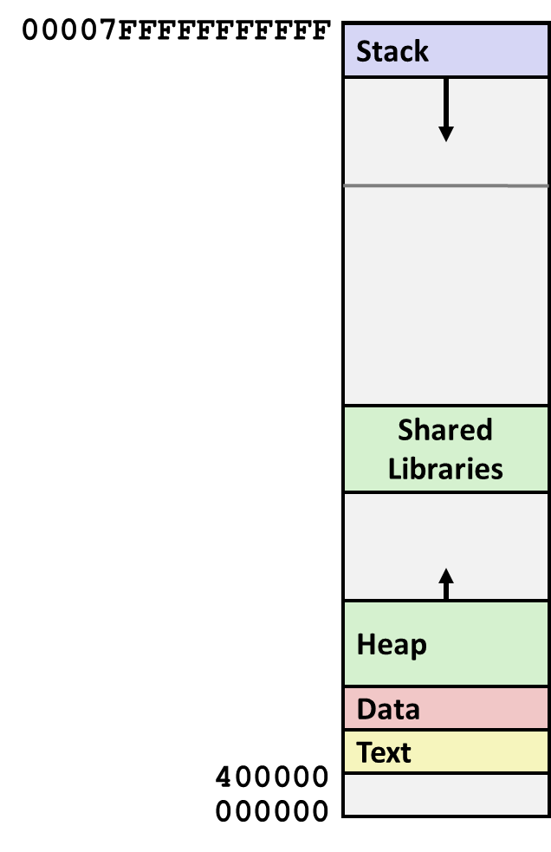
Recall: Each process can have the same address space
Process 1
Process 2
Process n
Solution: Virtual Memory

Slide 12
Address Space

Slide 13
Address Space Translation
Program operates in an address space that is distinct from the physical memory space of the machine
“virtual address”
“physical address”
0x000…
Processor
translator
Memory
Registers
0xFFF…

Slide 14
Translation through Page Table
Code
Data
Heap
Stack
Data 2
Code
Data
Heap
Stack
Stack 1
Heap 1
Code 1
Stack 2
Prog 1
Virtual
Address
Space 1
Prog 2
Virtual
Address
Space 2
Data 1
Heap 2
Code 2
OS code
Translation Map 1
OS data
Translation Map 2
OS heap &
Stacks
Physical Address Space

Slide 15
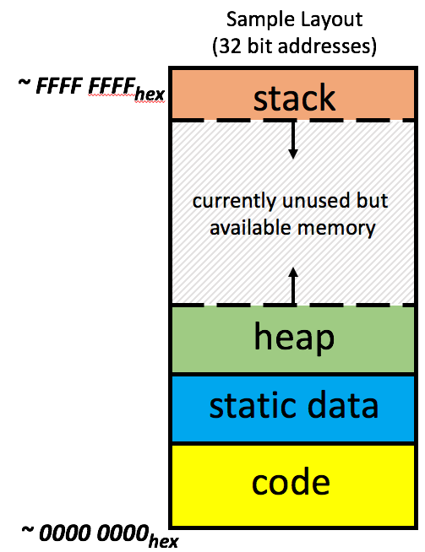
Recall: Processors operate in Virtual Address Space
Memory manager
Processor (& Caches)
?
Memory (DRAM)
Control
Datapath
Virtual Address
PC
Physical Address
Bytes
Registers
(ALU)
Many of these (software & hardware cores)
One main memory
Each Process uses it’s own address space
Processes use virtual addresses
Many processes, all using same (conflicting) addresses
Memory uses physical addresses (also, e.g., 0 ... 0xffff,ffff)
Memory manager maps virtual to physical addresses

Slide 16
The Third OS concepts – Threads

Slide 17
Thread
A single-execution stream of instructions that represents a separately schedulable task
OS can run, suspend, resume a thread at any time
bound to a process (lives in an address space)
Finite Progress Axiom: execution proceeds at some unspecified, non-zero speed
Each thread is very much like a separate process, except for one difference: they share the same address space and thus can access the same data
A multi-threaded program has more than one point of execution (i.e., multiple PCs, each of which is being fetched and executed from)

Slide 18
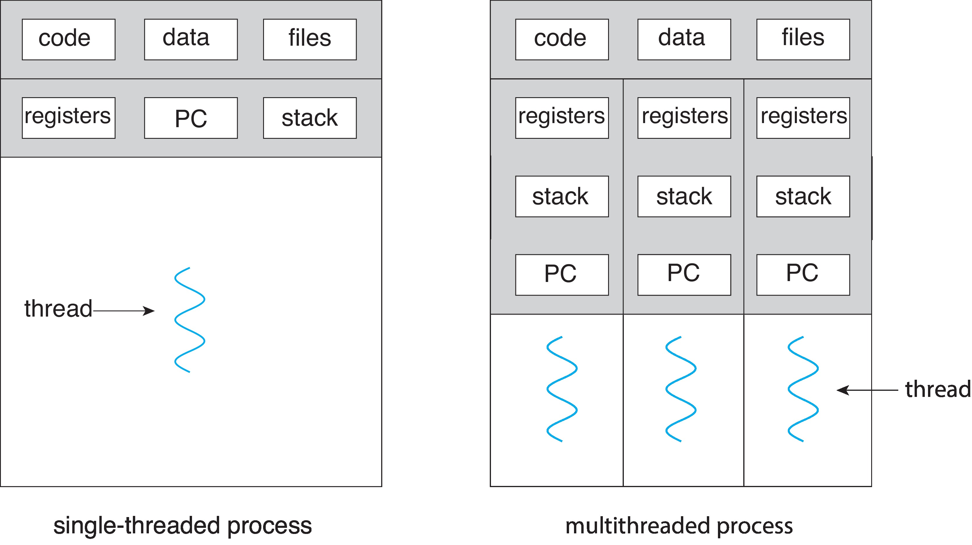
Single and Multithreaded Processes
Threads encapsulate concurrency: “Active” component
Address spaces encapsulate protection
Threads share memory; In processes – sharing memory is complex
Operating Systems Principles and Practice: Anderson and Dahlin

Slide 19
Thread of Control
Thread: Single unique execution context
Program Counter, Registers, Execution Flags, Stack, Memory State
A thread is executing on a processor (core) when it is resident in the processor registers
Resident means: Registers hold the root state (context) of the thread:
Including program counter (PC) register & currently executing instruction
PC points at next instruction in memory
Including intermediate values for ongoing computations
Can include actual values (like integers) or pointers to values in memory
Stack pointer (register) holds the address of the top of stack (which is in memory)

Slide 20
First OS Concept: Thread of Control
At the time of context switching, the register state of the running thread is saved into Thread Control Block (TCB)
Will study it later
A thread is suspended (not executing) when its state is not loaded (resident) into the processor
Processor state pointing at some other thread
Program counter register is not pointing at next instruction from this thread
Often: a copy of the last value for each register stored in memory

Slide 21
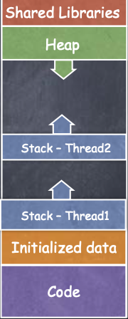
Thread
Process Address Space
All threads within a process share
Heap
Global/static data
Libraries
Each thread has a separate
Program Counter
Stack
Registers
Note two threads of the same process

Slide 22
The Fourth OS concepts – Dual Mode of Operation

Slide 23
Why do we need two (or more) modes of operation?
Why not have just one mode: User mode ?
Security?
Can a user access OS code and data?

Slide 24
User/Kernel (Privileged) Mode
User Mode
interrupt
exception
syscall
rtn
rfi
Kernel Mode
exit
exec
Limited HW access
Full HW access

Slide 25
Fourth OS Concept: Dual Mode Operation
Hardware provides at least two modes:
“Kernel” mode (or “supervisor” or “protected”)
“User” mode: Normal programs executed
What is needed in the hardware to support “dual mode” operation?
A bit of state (user/system mode bit)
Certain operations / actions only permitted in system/kernel mode
In user mode they fail or trap
User → Kernel transition sets kernel mode AND saves the user PC
Operating system code carefully puts aside user state then performs the necessary operations
Kernel → User transition clears kernel mode AND restores appropriate user PC
Example: return-from-interrupt

Slide 26
Lecture Summary
Program in execution is a process
In multiprogramming systems, one or multiple processes are resident in the main memory and they run concurrently
The process of switching the CPU from one process to another (stopping one and starting the next) is the context switch
Context switching is relatively expensive operation
An important OS data-structure for multiprogramming/context switching is Process Control Block
Will study PCB later in the course

